Slide 1
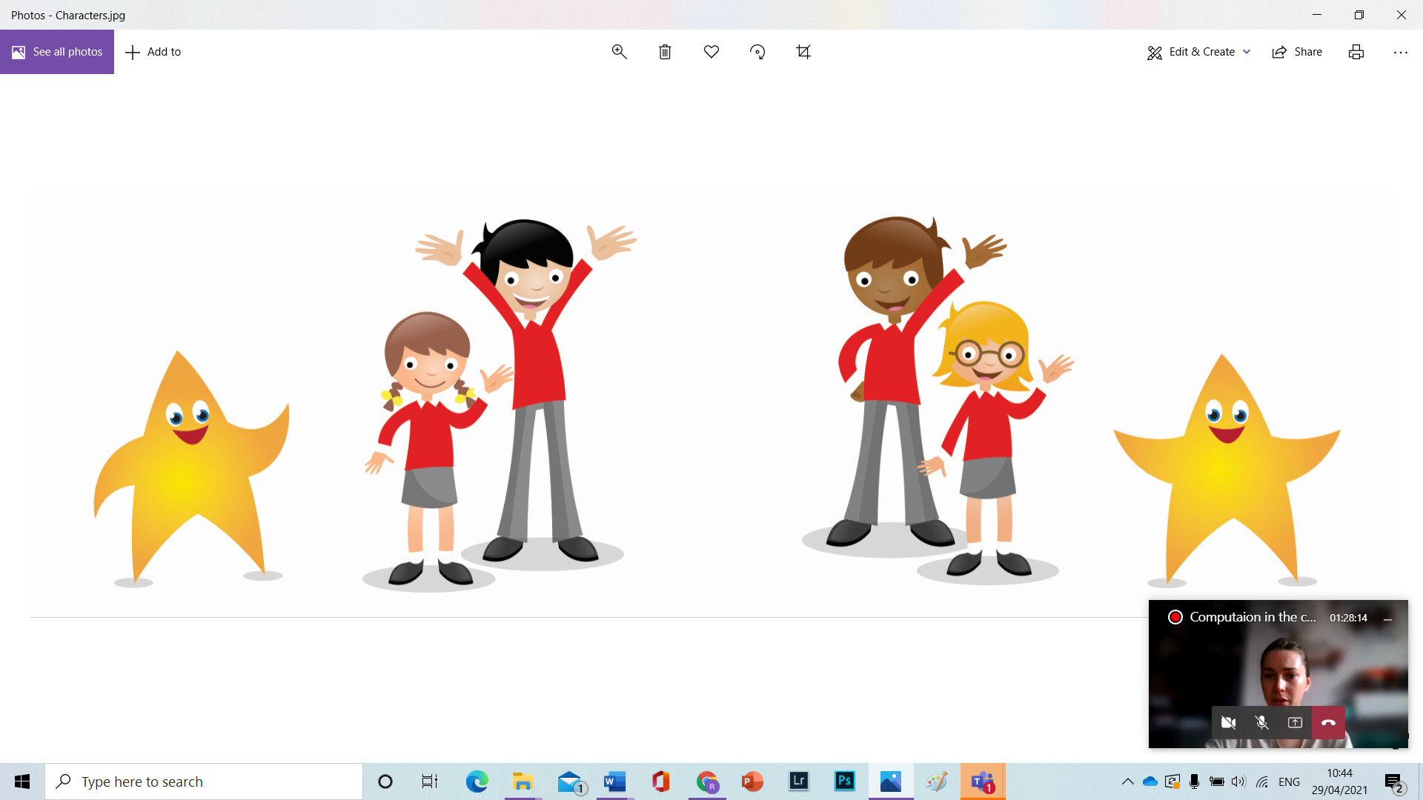
Birchgrove Primary School
Year 5
Curriculum Talk
2025 - 2026

Slide 2

To Year 5

Slide 3
Meet the team
Mr Davies - 5D
Miss Broughton - 5B
Mrs Ogden - TA
Mrs Hughes - TA

Slide 4
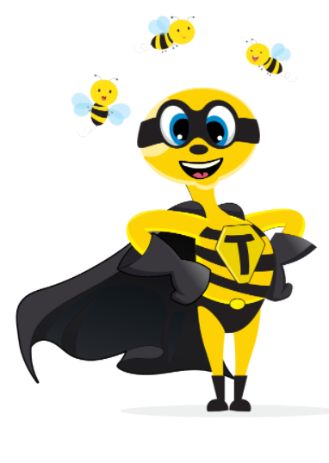
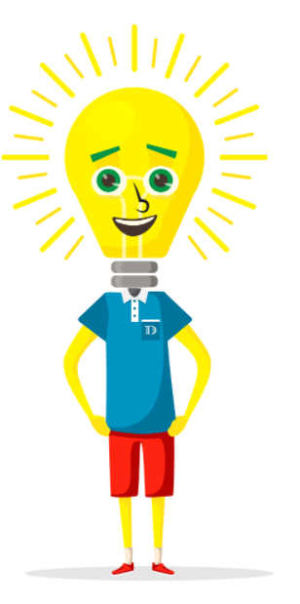
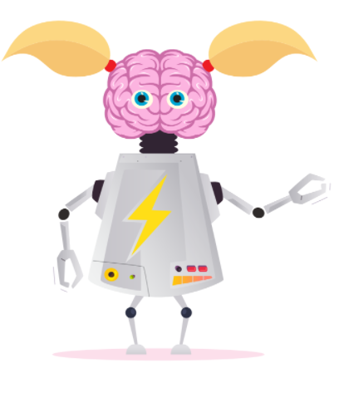
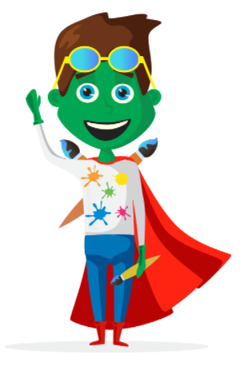
Our Learning Heroes
Meet our Learning Heroes. These colourful characters were designed by our pupils to help them understand the different attributes that make a well-rounded learner. Each hero has a special talent and are referenced along your child’s learning journey and used alongside other thinking tools such as; thinking maps, De Bono's hats and lots of reflective learning opportunities.
Teamwork Twm
Brainy Branwen
Decisions Dewi
Creative Cadi

Slide 5
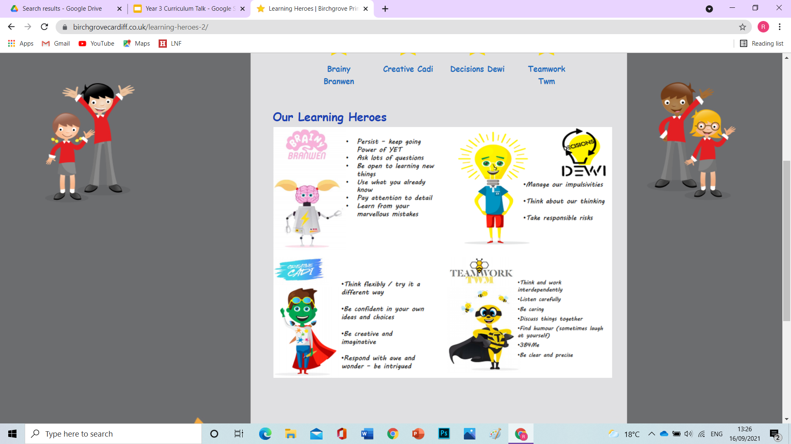
Our Learning Heroes’ Attributes

Slide 6
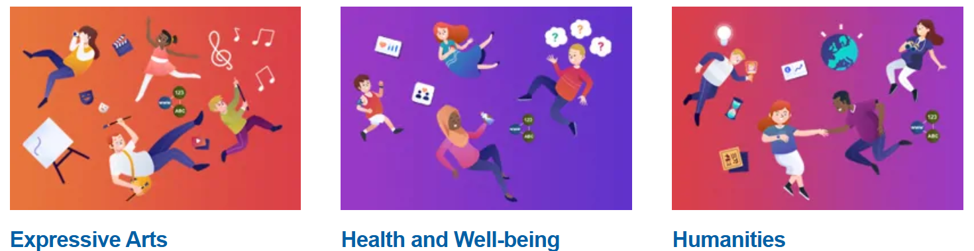
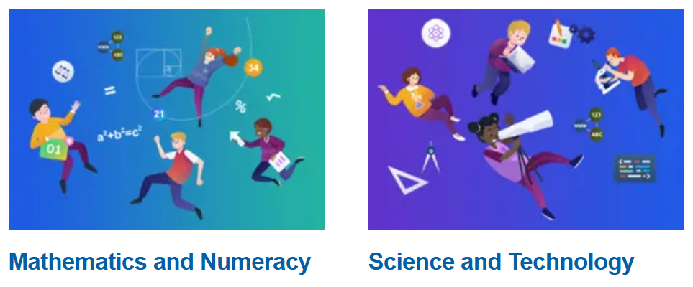
Year 5 Topics
In Year 5 children will have the opportunity to explore lots of new topics which will focus on each of the AoLE’s as outlined in the Welsh Curriculum.
The new curriculum 2022 has been designed so children can make decisions on how and what they want to learn. This allows us to choose topics that are of interest to our children and provide them with opportunities to learn through meaningful experiences. We will be using pupil voice to help us plan our future topics.
Numeracy, literacy and ICT skills are our core subjects are these skills will be taught across the curriculum so children have as many opportunities to rehearse and refine these important skills.

Slide 7
Beast Creator
🕷️ Beast Creator – Exploring Nature’s Networks
In this inquiry, pupils will build on prior knowledge to deepen their understanding of ecosystems, classification, and ethical thinking through hands-on exploration and debate.
🌿 Ecosystems & Adaptation
Pupils will investigate how living things depend on one another for survival, exploring food chains, food webs, and how insects are adapted to their environment. They’ll also identify the functions of common plant organs like roots, stems, and leaves.
🔍 Classification & Observation
Using observation and scientific enquiry, pupils will examine the body parts of minibeasts and use classification keys to group animals and plants based on their features and functions.
🧬 Ethics & Innovation
They'll debate the ethics of genetic modification and explore the impact of human actions on ecosystems. Applying their learning creatively, pupils will design their own unique minibeast, justifying their choices using scientific knowledge.

Slide 8
Pox, Plots and Pudding Lane
🔥 Pox, Plots and Pudding Lane – Exploring the Stuarts
In this inquiry, pupils will journey back to the 1600s to explore key events like the Gunpowder Plot, the Great Plague, the Great Fire of London, and the Civil Wars. They’ll develop a deeper understanding of this transformative period through various historical sources.
🏠 Life in the 1600s & Significant Figures
Pupils will explore daily life in Stuart England, comparing it to their own, and learn about key figures such as Samuel Pepys and Oliver Cromwell. They’ll study historical events and understand how these shaped society.
🕰️ Chronology, Cause & Effect
Through sequencing events and considering cause and effect, pupils will investigate how events like the Great Fire of London and the Plague started, spread, and were difficult to control. They’ll compare these historical events with modern-day pandemics and think about how we can prevent similar situations today.
📚 Historical Sources & Bias
Pupils will critically examine historical sources such as Pepys’ diary, learning to distinguish between facts and opinions. They’ll consider how evidence can be biased and how interpretations of events may differ, particularly regarding the monarchy and the banning of Christmas during the Civil Wars.

Slide 9
Scream Machine
🎢 Scream Machine – Exploring Forces and Energy
In this inquiry, pupils will deepen their understanding of forces, energy, and how these affect the world around them. They’ll explore different types of energy, mechanisms, and the impact of science and technology on everyday life.
🌪️ Forces & Energy
Building on their Year 4 knowledge, pupils will investigate various forces like gravity, air resistance, and friction, exploring how energy can be transferred through potential and kinetic energy. They'll conduct investigations such as testing paper planes to see how streamlining affects speed and direction.
🔧 Mechanisms & Technology
Pupils will explore moving mechanisms like pulleys, cams, hydraulic pressure, and magnetism. They’ll understand how these mechanisms work and apply this knowledge to real-world examples, such as roller coasters, where gravity plays a major role in their design.
🏗️ Designing a Roller Coaster & Social Impact
Using their understanding of forces, pupils will design their own roller coasters, experimenting with gravity and other forces. They’ll also debate the social and environmental impacts of building a theme park, writing persuasive letters to council members to argue their case.

Slide 10
Our Wonderful World
🌍 Our Wonderful World – Exploring Identity, Culture & Sustainability
In this inquiry, pupils will reflect on what makes our world wonderful, how we can protect it, and whether it’s wonderful for everyone. They’ll explore identity, culture, and how their actions can impact the world around them.
💡 Identity & Belonging
Pupils will ask big questions about their own identity and culture, celebrating Welsh heritage while also valuing individual ethnicity and identities within the class. They will make connections with people and places across Wales and the globe, fostering pride and understanding.
🌍 Geography & Global Connections
Through geographical studies, pupils will explore the Wonders of the World and select a Welsh wonder. They’ll develop their skills in mapping and research, deepening their understanding of global and local landmarks, and connect with the world beyond their own community.
🌱 Rights, Responsibilities & Sustainability
Pupils will explore their rights and responsibilities, considering whether society is fair and inclusive. They’ll investigate topics like Fair Trade, carbon footprints, air miles, and sustainable tourism, reflecting on how our choices impact the world and how we can make a positive difference.

Slide 11
Champions
🏅 Champions – Building Healthy Habits & Sports Skills
In this inquiry, pupils will focus on maintaining a healthy lifestyle, exploring exercise, nutrition, and the mindset needed to be a champion, both individually and as part of a team.
💪 Exercise, Body & Wellbeing
Pupils will deepen their understanding of the body's muscles and the importance of warming up before exercise. They’ll explore the effects of exercise on heart rate and carry out investigations, asking questions like "Does height affect jumping distance?" or "Are taller people faster runners?" to draw their own conclusions.
🍎 Healthy Eating & Athlete’s Lifestyle
Building on their knowledge of healthy eating, pupils will apply their understanding of food groups and balanced diets to create meal plans for athletes. They’ll also explore what it takes to be a champion, focusing on qualities like teamwork, persistence, and how to apply these traits in their own lives.
⚽ Teamwork, Materials & Sporting Innovation
Pupils will collaborate to design a new game, complete with rules and a scoring system, and teach it to others. They’ll also explore the properties of different materials, like strength and flexibility, to understand how they are used in sports equipment and clothing. They’ll have opportunities to talk to real-life champions about their achievements and lifestyles.

Slide 12

Mathematics
Daily Maths Lessons
All children will take part in daily maths lessons. These are carefully planned to build fluency, confidence and problem-solving skills and to ensure that every child is supported and challenged appropriately.
Maths Grouping Across the Year Group
Children will be grouped for maths across the year group based on teacher assessments, classroom observations and discussions with their previous teachers. This helps us tailor teaching to each child’s current stage of learning. These groups are flexible and reviewed regularly to reflect children’s progress.
Maths Across the Curriculum
In addition to daily lessons, maths will also be taught through other areas of the curriculum and within topic work. This helps children see how maths connects to real-life situations and other subjects.
Weekly Maths Investigations
Each week, children will take part in a maths investigation. These sessions are designed to develop their reasoning and problem-solving skills in a fun and engaging way.
Supporting Learning at Home
We will also be recommending websites and online resources that children can use at home to practise and reinforce the skills taught in class. These will be shared regularly and are a great way to support your child’s learning.
This Term’s Focus
In the first part of the term, our focus will be on place value, helping children understand the value of digits in numbers. We will then move on to number work involving the four operations: addition, subtraction, multiplication and division.

Slide 13
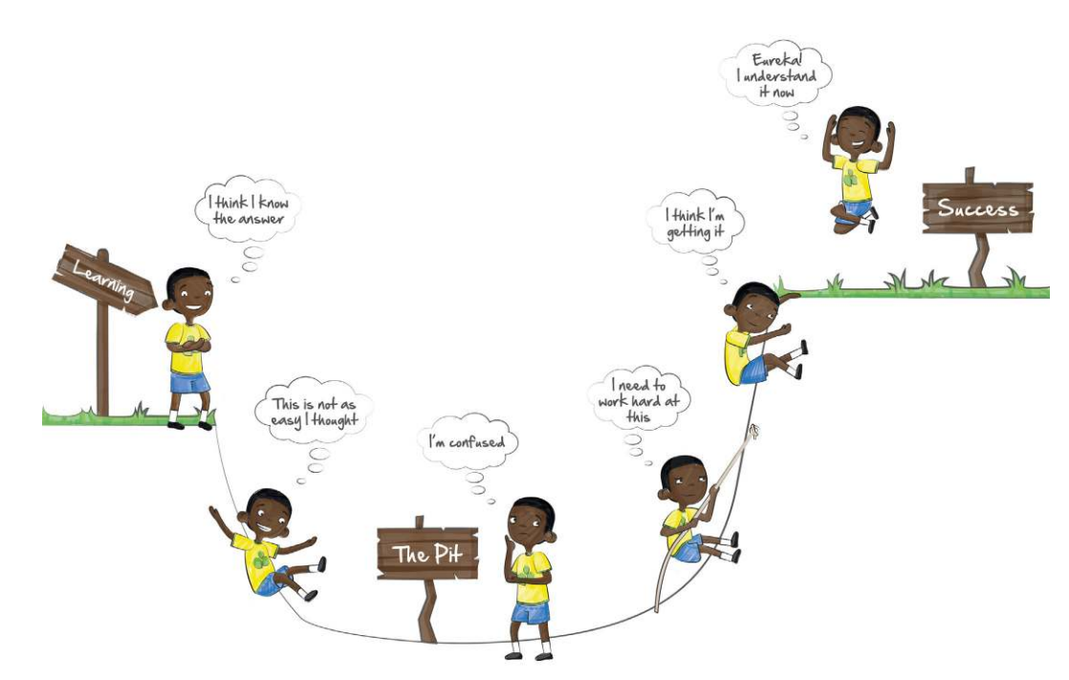
The Learning Pit

Slide 14
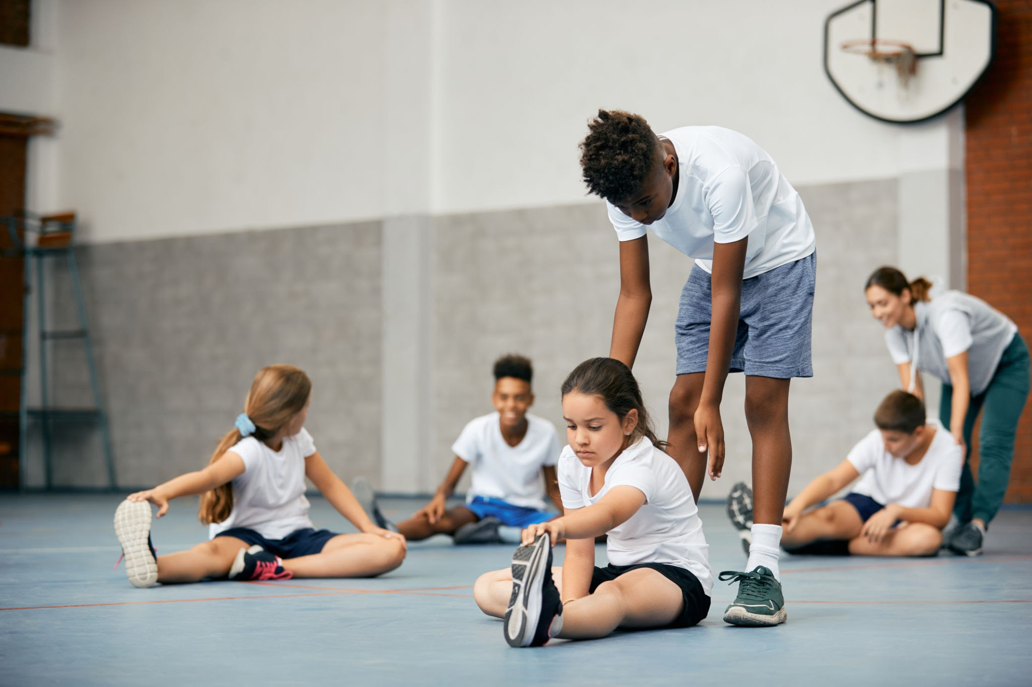

P.E. (Health and Well-Being)
Indoor P.E sessions for both classes will take place on Tuesday afternoons.
Outdoor PE sessions for both classes will be on Wednesday afternoons.
IMPORTANT
Children must bring their PE kits into school and not wear them in. As part of RSE, we are encouraging good hygiene and changing for sports is an important part.
All pupils will need the correct PE kits for lessons. This includes; a yellow top, leggings/joggers/shorts, trainers and a jacket or hoodie for when the weather changes.

Slide 15

Online Safety
iMessage - suitable for all
Minecraft - no age limit, but suitable for aged 8+
Roblox - 10+
Fortnite - 12+
Google Duo - 13+, but designed for kids with very little risk
Discord - 13+
Tik Tok 13+
Snapchat 13+
Whatsapp - 13+
Twitch - 13+ (open platform)
Important things to note:
Set parental controls
Monitor your child’s phone
Ensure privacy settings are high
Limit screen time, especially before bed
Phones should not be used in secluded areas

Slide 16


Slide 17

PE Days - Tuesdays PM
Wednesdays PM
Tuesday 23rd September - Individual photos
Wednesday 24th September - Walk to Heath Park
Friday 24th October - Break up for HALF TERM!
Beginning of day arrangements

